Slide 1
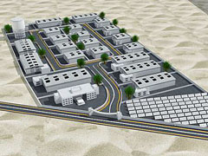
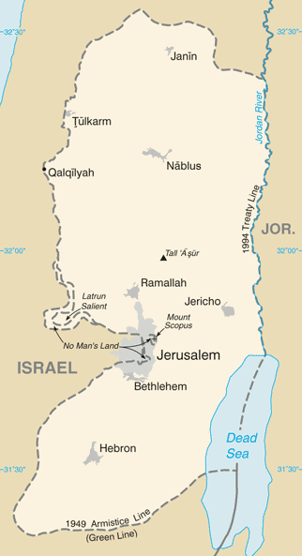
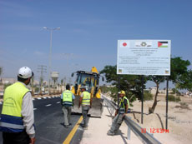
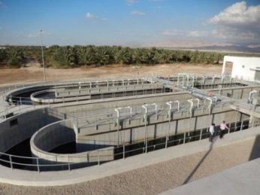
JAIP: Jericho Agro-Industrial Park
October 2018
“Corridor for Peace and Prosperity” Initiative is a mid-and long-term effort of Japan to support economic and social development in Palestine through regional cooperation among Palestine, Israel, Jordan and Japan.
Jericho Agro-Industrial Park (JAIP) is a flagship project of the initiative.
1. Progress
JAIP is composed of three land parcels; Phase 1 (11.5 ha), Phase 2 (50 ha), Phase 3 (50 ha). Currently, Phase 1 is under development.
32 Palestinian companies signed lease agreements with the park. 13 companies started operations.
About 200 Palestinians are employed in JAIP. About 3400 Palestinians would be employed in JAIP at the end of Phase 2, according to PA estimation.
2. Support from Japan
Japan has been providing assistance of over USD 21 million for the development of JAIP.
Japan also supported regional development projects in Jericho such as construction of roads, wastewater treatment facility and solid waste treatment plant, all of which also benefit JAIP.
Jericho Agro-Industrial Park (JAIP)P
JAIP image after completion
3 Challenges ahead
Increasing the number of tenants
Securing stable supply of water and electricity
Development of distribution routes for markets abroad
Road construction in Jericho city
Jericho wastewater treatment facility

Slide 2
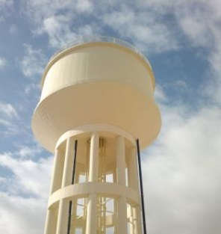
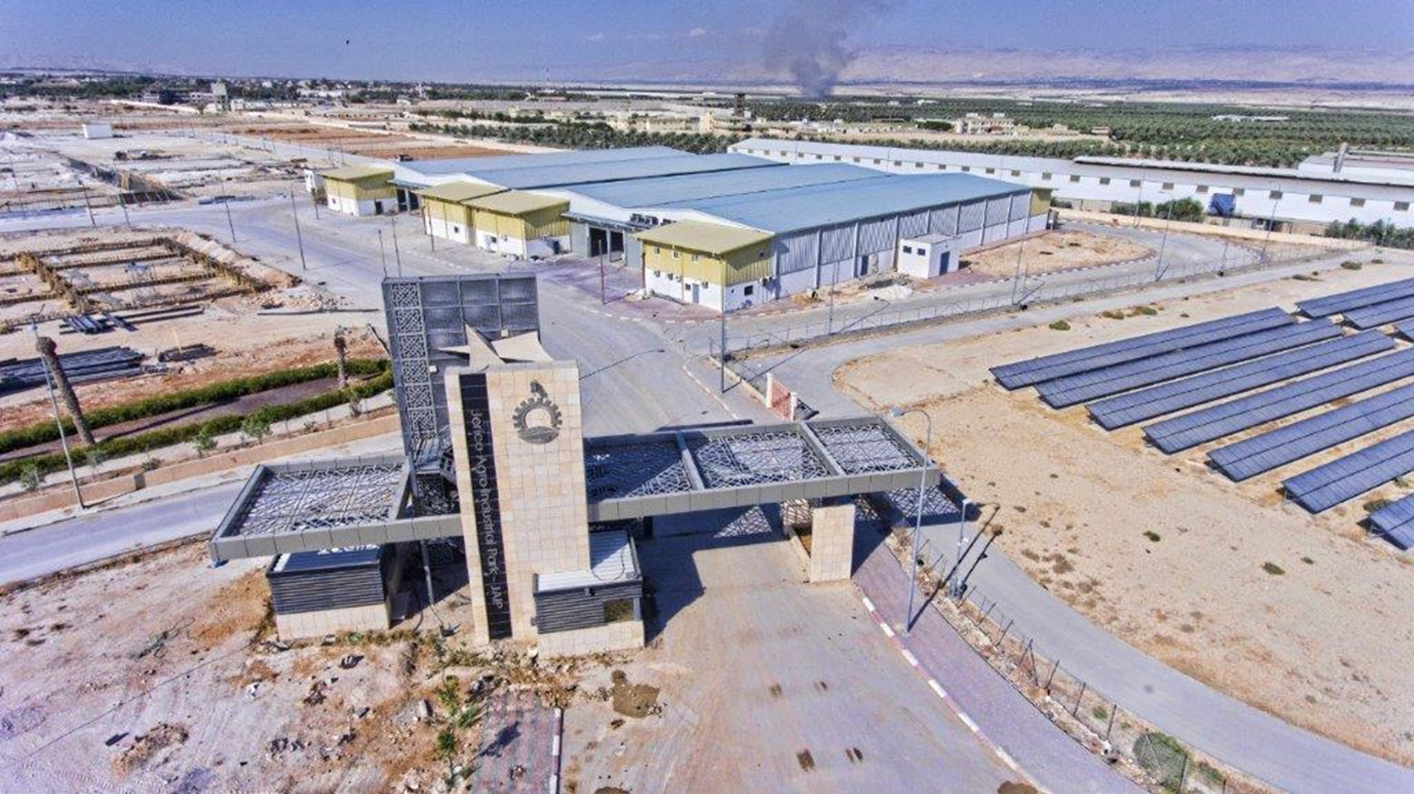
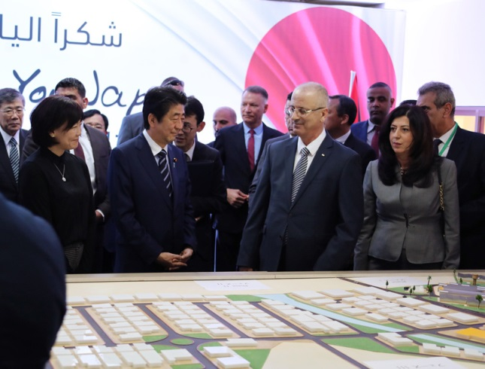
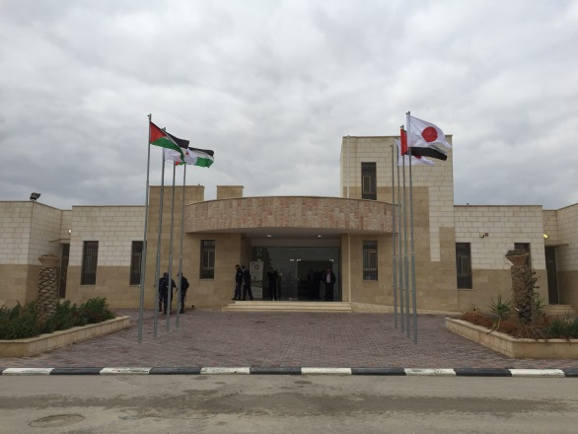
Recent photos
Elevated water tank
(Funded by Japan)
Factories
Photovoltaic park
(Funded by Japan)
Visit by
Prime Minister Abe
（2018.5.2）
Administration building
(Funded by Japan)

Slide 3
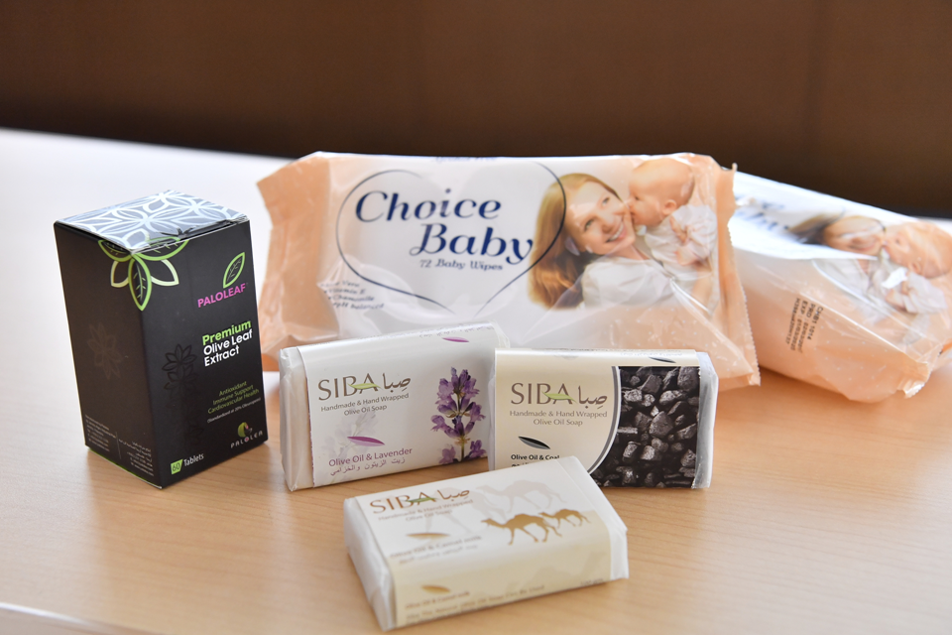
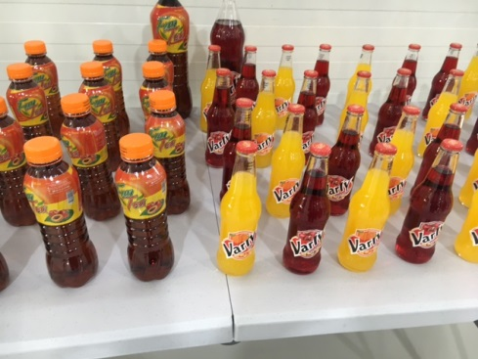
Operating Companies
Palolea Company
(Olive Leaf Extract)
2015.11~
12 employees (30 seasonal employees)
Choice Co.
(Wet Tissue)
12 employees
Siba company
(Organic soap)
2017.3~
5 employees
Al Masra
(Soft Drink)2018.1~
15 employees
Paper Pal Company
(Recycle Paper) 2017.7~
17 employees
Rihana
(Frozen Potatoes) 2017.4~
11 employees
Foam Machine Horizontal
(Packing products)
2016.1~
13 employees
Hawamdeh Company
(Mineral Water) 2016.12~
12 employees
Kingdom Dates
(Dates Powder) 2018.4~
9 employees
Moon Valley Company
(Dates packaging ) 2017.10~
5 Employees (40 seasonal)
Euro Med
(Nuts products) 2018.4~
7 employees
Ostry for Agricultural Development (Paper ) 2018.4~
8 employees

Slide 4
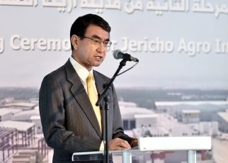
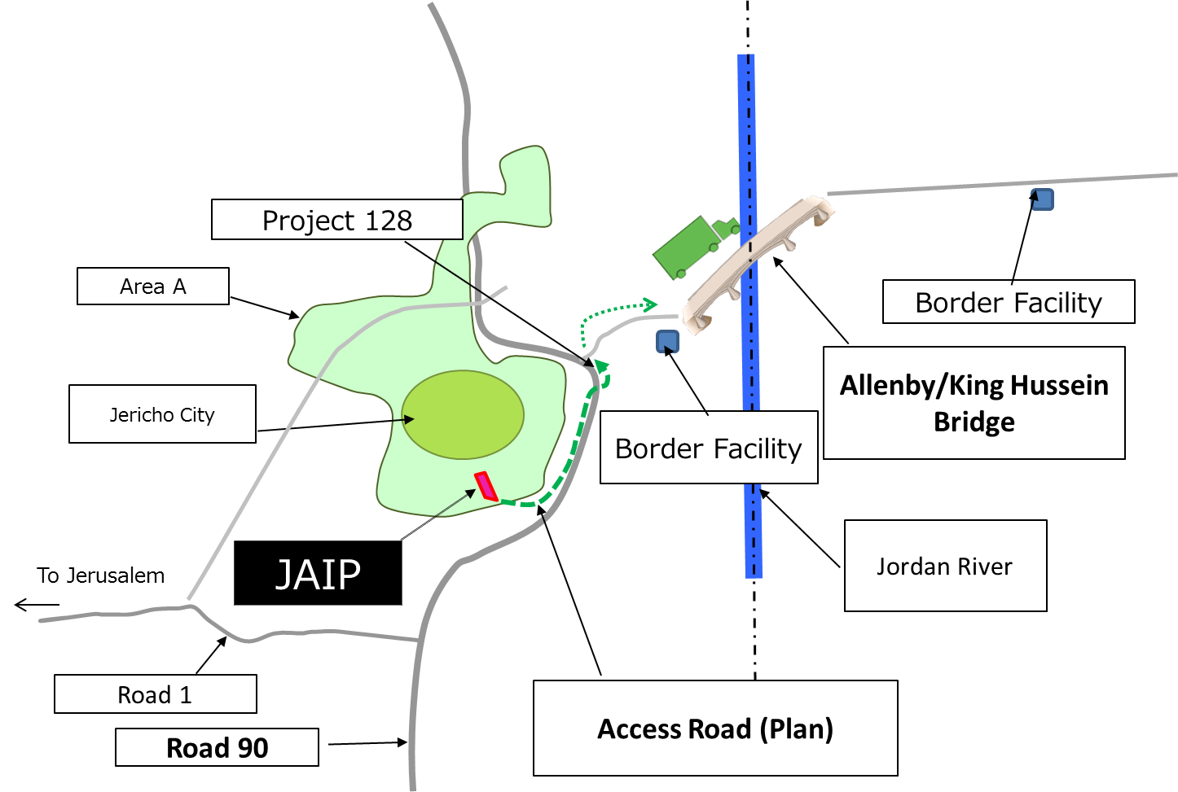
Grade-up of the “Corridor for Peace and Prosperity” initiative
◆ Foreign Minister Kono announced upgrade of the initiative focusing on ICT sector and facilitating logistics as below:
1 ICT sector
Industrial capacity building center including ICT entrepreneur desk in JAIP
Policy advisor to support PA for making ICT policy and related laws
Competition on ICT entrepreneurs and invite winners to Japan
Capacity building on ICT sector utilizing CEAPAD
Collaboration with Palestinian universities and ICT related institutions
2 Facilitating Logistics
Construction of an access road from JAIP to Allenby/King Hussein Bridge
Contribution to projects on the Jordanian border facilities at the Bridge

